Slide 1

IE 7500: Question/Answering using Encoder and Decoder Transformers
Samani Karan: samani.k@northeastern.edu
Kota Mohit: kota.mo@northeastern.edu
Desai Saharsh: desai.sah@northeastern.edu

Slide 2
Objective
The objective is to Perform “Question/Answering” using state of art transformers.
The problem we selected for this project is related to how different architectures of encoders and decoders in the transformers perform Q/A on general data and biomedical data.
The aim is to see how a transformer model with both encoder and decoder is better than just an encoder stacked transformer model in summarizing the predicted answer.
Transformer model uses self-attention as a technique to perform inferencing and this kind of mechanism helps to improve the downstream Question/Answering task.

Slide 3
Approach and Current State of Art

Slide 4
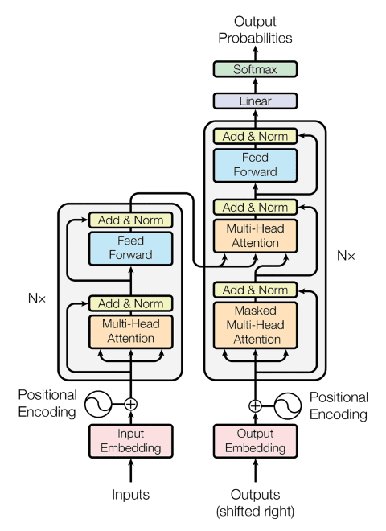
Transformer Model Definition The transformer model is a neural network that learns context and meaning by tracking relationships in sequential data such as the words in sentences. These models apply self-attention mathematical techniques, to detect subtle ways even distant data elements in a series influence and depend on each other. Encoder The task of the encoder is to map an input sequence to a sequence of continuous representations, which is then fed into a decoder. Decoder The task of the decoder is to receive the output of the encoder together with the decoder output at the previous time step, to generate an output sequence.

Slide 5
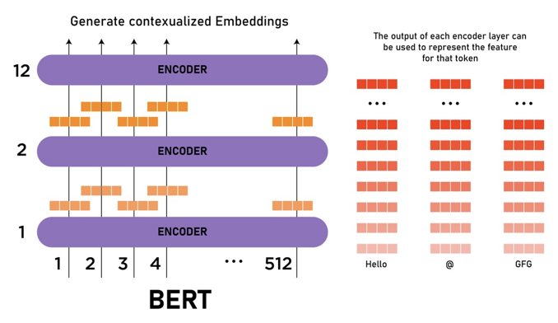
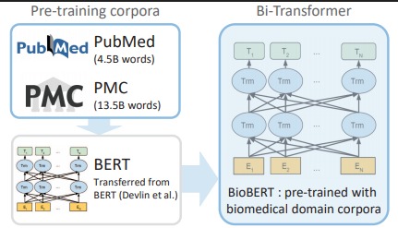
Encoder Models
BERT
BioBERT
BERT is a transformer model pretrained on a large corpus of English data in a self-supervised fashion.
BioBERT is a transformer model pretrained on large medical corpus known as "PMC" and "PubMed".
It makes use of Transformer, an attention mechanism that learns contextual relations between words in a text. It is considered bidirectional.
These models are a stack of transformer encoder. of

Slide 6
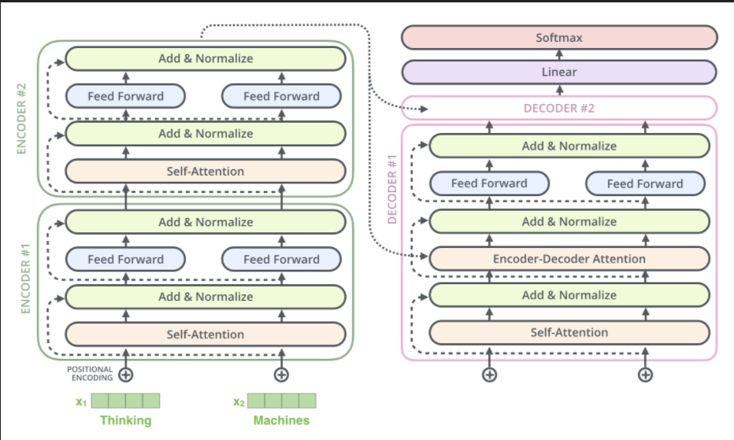
Encoder and Decoder Model
T-5 Transformer
The T5 transformer is a slightly different transformer than the previous encoder transformers.
Where the previous encoder transformers needed the start and end tokens as the target, here we don’t need starting or ending tokens.
We just need the text of the answer as the target.
Hence, here we need only three things, Context, Question, Answer.
T5 is the simplest and more powerful of all the three transformers as it has both encoder and decoder and is also known as a multi- purpose transformer as it can be used to perform numerous downstream tasks.
of

Slide 7
Corpus to be Used
The two open-source datasets we will be using are:
Squad Dataset.
Link: Stanford Question Answering Dataset | Kaggle
PubMed dataset.
Link: pubmed · Datasets at Hugging Face
of

Slide 8
Thank you
of

